Slide 1

Lesson 5: SEO Best Practices
Kubilay Cagatay
WEB 225

Slide 2

SEO mistakes to avoid
When you decide to start optimizing your website for search, there are some common mistakes you want to avoid.
How can you make sure you skip over the rookie mistakes and start using SEO to your advantage?
Here are some common pitfalls to avoid.

Slide 3

Header tags and keyword phrases
A header tag, also known as an H1 tag, is much like the subject line of your web page.
You should only use your keyword phrase once in the H1 tag. This should be included on a page to which you are trying to drive unique traffic to.
You can also use H2 tags if there are multiple sections.

Slide 4

Best Practices
Use your keyword phrase once in your H1 tag
Use H1 tags on pages you are trying to drive unique traffic to SEO page
Use H2 tags if there are multiple sections

Slide 5

Content with targeted keyword phrases
Your content is the main dish of your website. With all of the Google updates, it is extremely important that your content is unique and relevant.
If you have multiple pages with the same content, you will run the risk of getting penalized by Google and your search rankings will suffer.

Slide 6
Best Practices
Create content that is extremely relevant for that keyword phrase
Use your keyword phrase 4 times within your content
Include links from other pages within your website that point back to this page

Slide 7

Meta descriptions
Meta descriptions, while not as important in search engine rankings, are extremely important in getting users to click through from the search engine results page to your website.
Meta descriptions should use keywords wisely, but more importantly they should include a compelling description on which a user would want to click on.
Much like title tags, the SERPs will highlight keywords that the user searched for, increasing the likelihood of the user clicking through to your website.

Slide 8
Best practices
Write compelling meta descriptions
150 to 160 characters is the recommended length
Avoid duplicate meta descriptions
Do not use quotes or any non-alpha characters

Slide 9
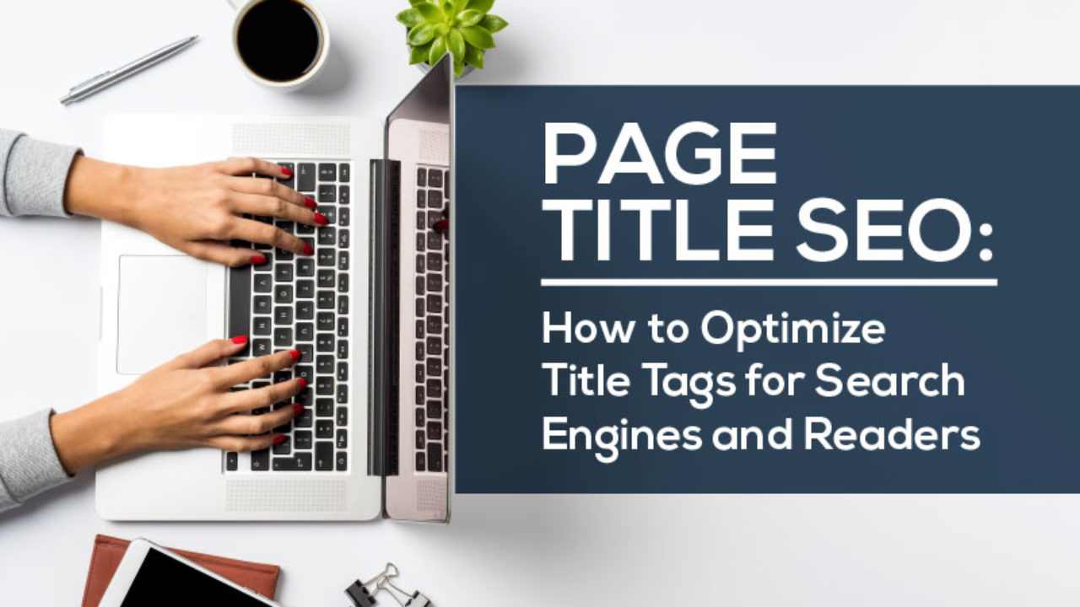
Title tags
The title tag tells search engines what the page is about and that the page on your website is relevant for that keyword or keyword phrase.
Title tags should be unique for every page. In search results, search engines will highlight your keyword phrases if a user has searched for those terms.
This increases visibility and click through rate.

Slide 10
Best practices
Your title tag should be written like this: Primary Keyword – Secondary Keyword | Brand Name
Use a dash in between your keyword phrases and a pipe at the end before your brand name
Avoid duplicate title tags
Keep title tags at 55 characters or less in length, including spaces.

Slide 11
Thank You!

